Slide 1
Xunfei SDK + Unity
Aleksandar Todorovic

Slide 2
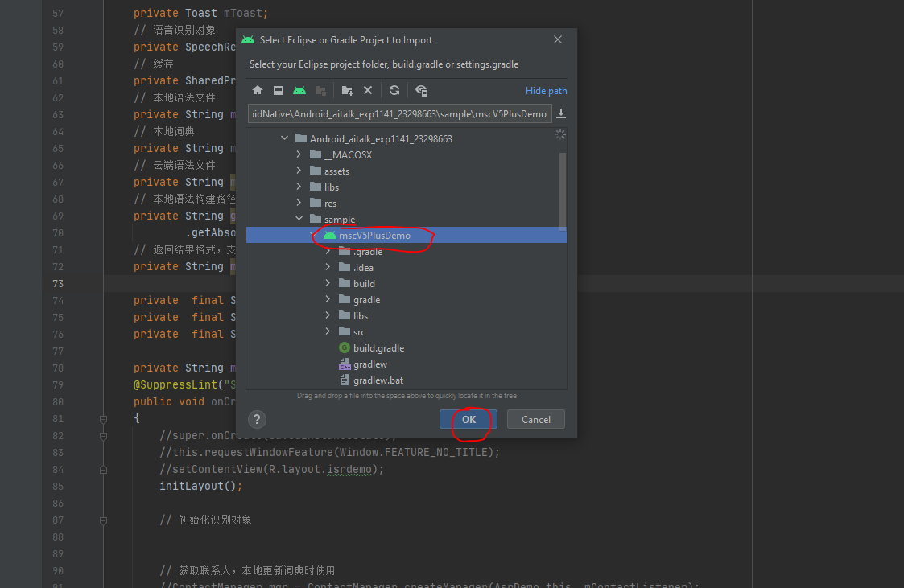
Import SDK Project with Android Studio

Slide 3
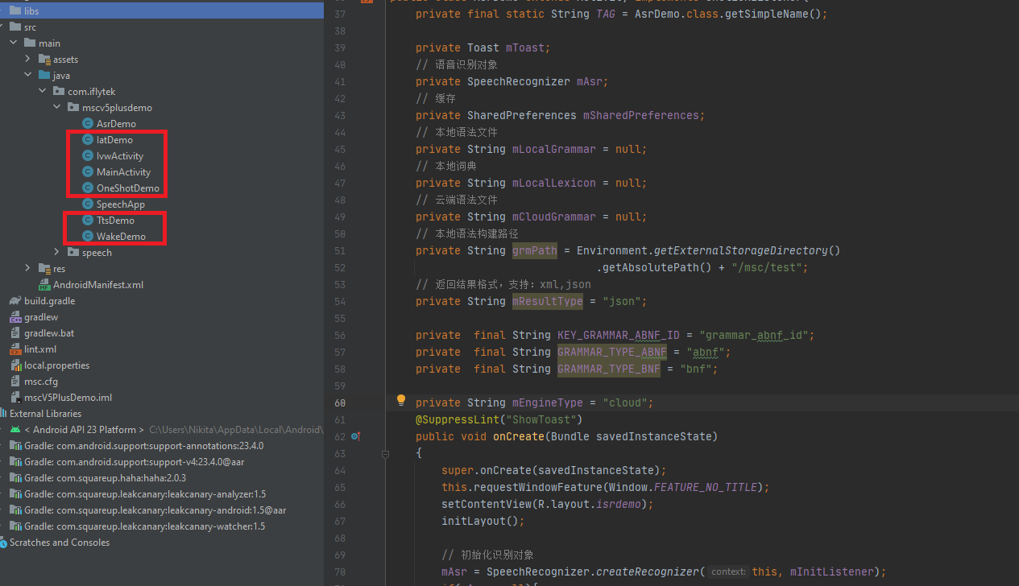
Because we are running the offline command word recognition function, these scripts are used by other functions, so just delete them directly

Slide 4
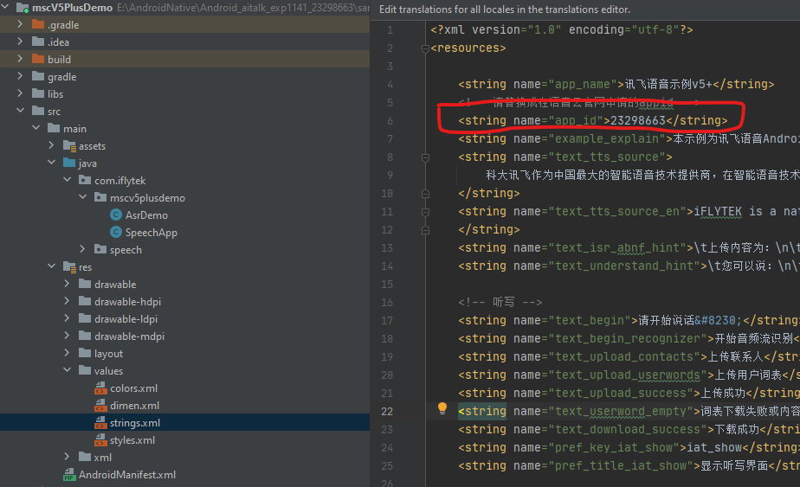
Check app_id in the android studio project.

Slide 5
Change the AsrDemo.Java file as like in the source project. That is for unity plugin.
3 main functions.
InitAsr(); //initialize the recognition
Buildsyntax(); //construct grammar
StartRecognize(); //start recognize

Slide 6
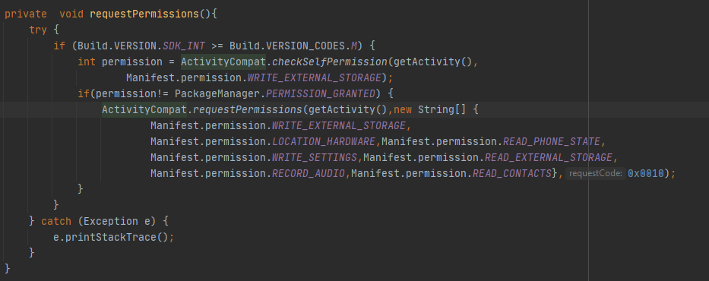
This function is for request permissions for mobile phone.

Slide 7
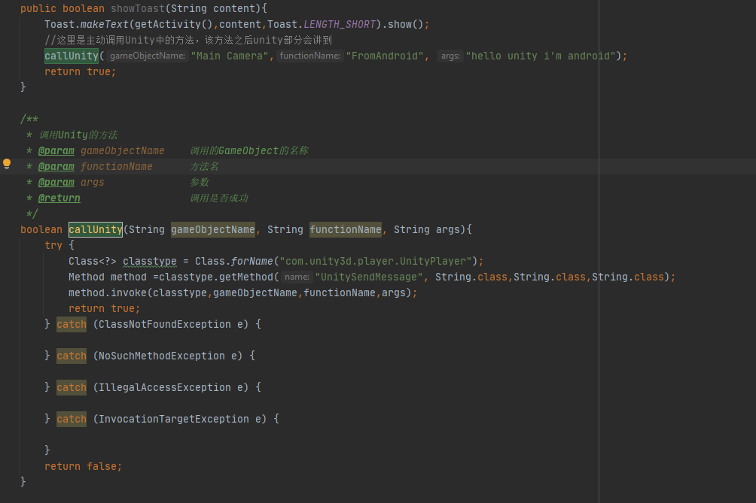
This function is for calling the Unity function from Android Plugin.

Slide 8
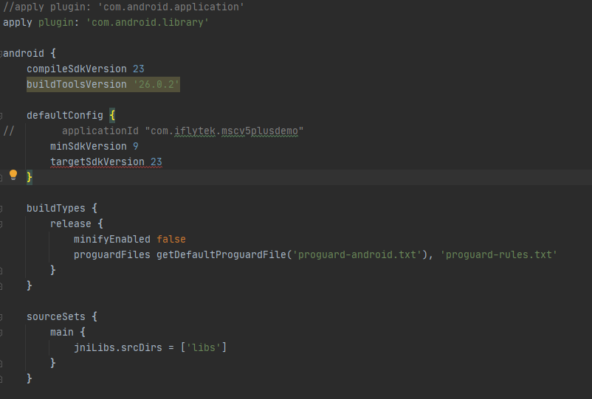
Change build.gradle to Android Plugin

Slide 9
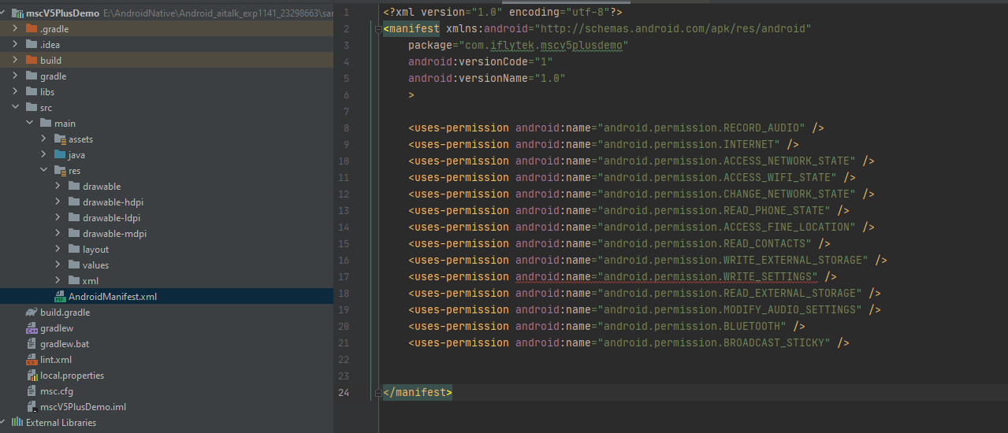
Modify the AndroidManifest.xml file, we don’t need to leave some activity files, ours is just an aar package.

Slide 10
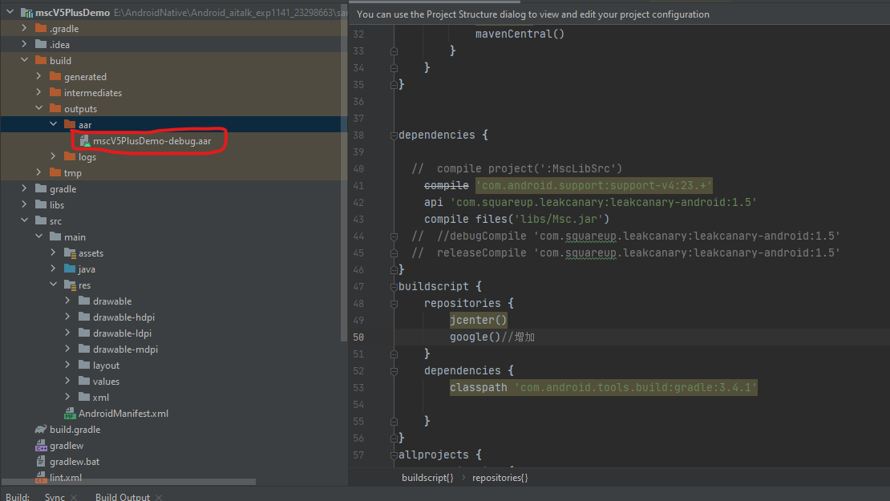
After these , build the project and you can get aar library.

Slide 11
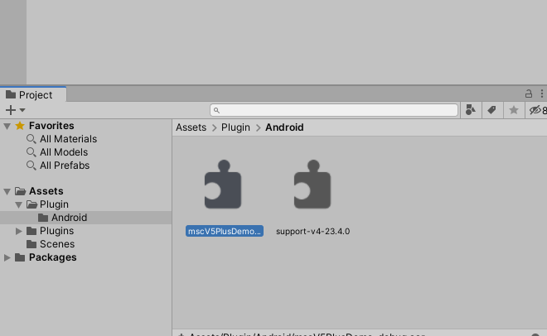
Copy this mscV5PlusDemo-debug.aar to Unity project. The support-v4-23.4.0.aar should be copied here because to request permissions in this Unity Project.

Slide 12
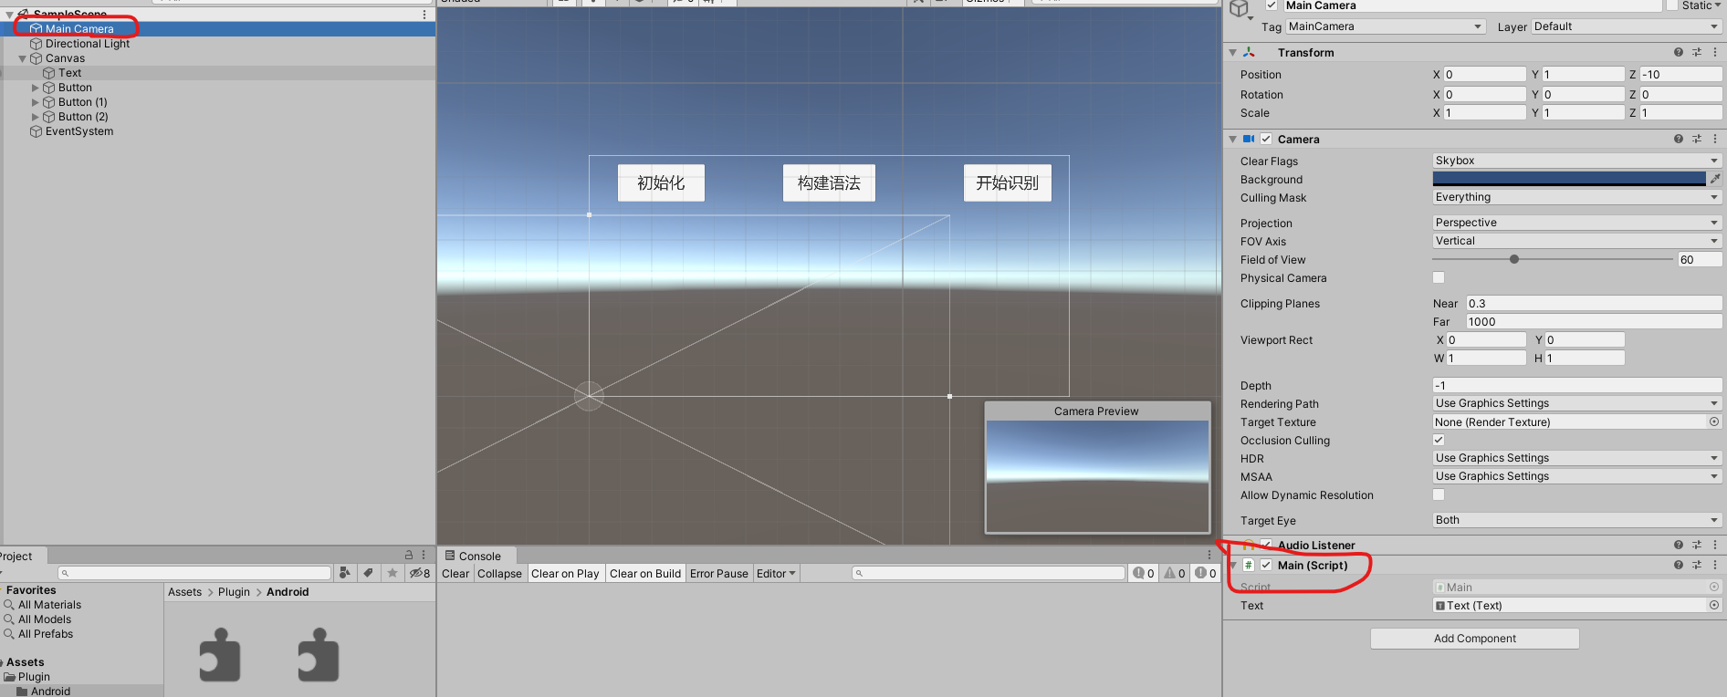
In this project, add Main.cs to Main Camera object. Remember this gameobject name “Main Camera” , because we used this gameobject name in the android project.

Slide 13
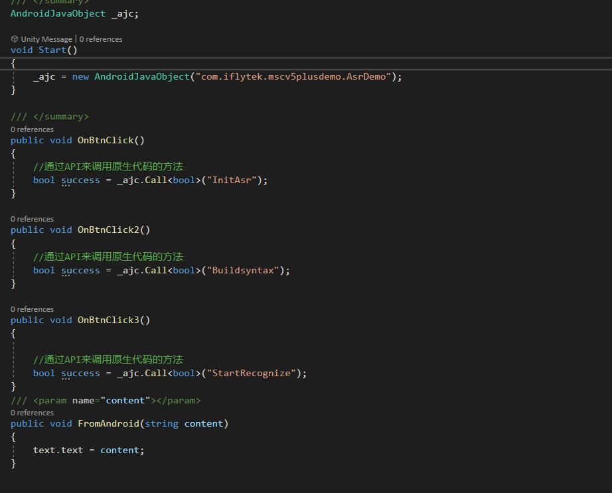
Edit the Main.cs as source project. AsrDemo is the class name of the android project.
Call the plugin functions using .call<bool>(“functionName”);
FromAndroid is called from plugin with the parameter.

Slide 14
After that, you can build your unity project and test.
Thank you Chen from Alek

